Slide 1
Analyzing adult census income data
With decision tree and logistic regression
Presented by:
Peiyu wang, Ziqiu zhu and zhijie ren

Slide 2
Background of this dataset
This data was extracted from the 1994 Census bureau database by Ronny Kohavi and Barry Becker (Data Mining and Visualization, Silicon Graphics). A set of reasonably clean records was extracted using the following conditions: ((AAGE>16) && (AGI>100) && (AFNLWGT>1) && (HRSWK>0)). The prediction task is to determine whether a person makes over $50K a year.

Slide 3
Variable Description
Age: continuous variable, describes the age of the person
Workclass: categorical variable, describes the work class of the person, possible values: Private, Self-emp-not-inc, Self-emp-inc, Federal-gov, Local-gov, State-gov, Without-pay, Never-worked
fnlwgt: continuous variable, the term estimate refers to population totals derived from CPS by creating "weighted tallies" of any specified socio-economic characteristics of the population.
Education: categorical variable, possible values: Bachelors, Some-college, 11th, HS-grad, Prof-school, Assoc-acdm, Assoc-voc, 9th, 7th-8th, 12th, Masters, 1st-4th, 10th, Doctorate, 5th-6th, Preschool

Slide 4
Variable description
education-num: Continuous Variable
marital-status: Categorical Variable, possible values: Married-civ-spouse, Divorced, Never-married, Separated, Widowed, Married-spouse-absent, Married-AF-spouse
occupation: Categorical Variable, possible values: Tech-support, Craft-repair, Other-service, Sales, Exec-managerial, Prof-specialty, Handlers-cleaners, Machine-op-inspct, Adm-clerical, Farming-fishing, Transport-moving, Priv-house-serv, Protective-serv, Armed-Forces
relationship: Categorical Variable, possible values: Wife, Own-child, Husband, Not-in-family, Other-relative, Unmarried

Slide 5
Variable description
race: Categorical Variable, possible values: White, Asian-Pac-Islander, Amer-Indian-Eskimo, Other, Black
sex: Categorical Variable, possible values: Female, Male
capital-gain: Continuous Variable
capital-loss: Continuous Variable
hours-per-week: Continuous Variable

Slide 6
Variable description
native-country: Categorical Variable, possible values: United-States, Cambodia, England, Puerto-Rico, Canada, Germany, Outlying-US(Guam-USVI-etc), India, Japan, Greece, South, China, Cuba, Iran, Honduras, Philippines, Italy, Poland, Jamaica, Vietnam, Mexico, Portugal, Ireland, France, Dominican-Republic, Laos, Ecuador, Taiwan, Haiti, Columbia, Hungary, Guatemala, Nicaragua, Scotland, Thailand, Yugoslavia, El-Salvador, Trinadad&Tobago, Peru, Hong, Holand-Netherlands
Income: Categorical Variable, possible values: <=50k, >50k

Slide 7
Objectives of our analysis
Build a reliable logistic model to indicate which features would significantly affect the income, and to use the model to predict the income
Build a decision tree to predict the probability of a certain incident’s happening

Slide 8
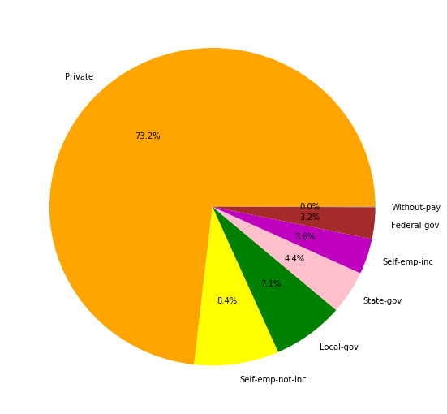
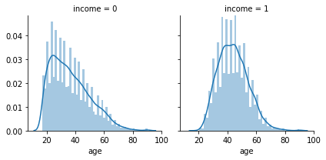
iNITIAL Data vISUALIZATION

Slide 9
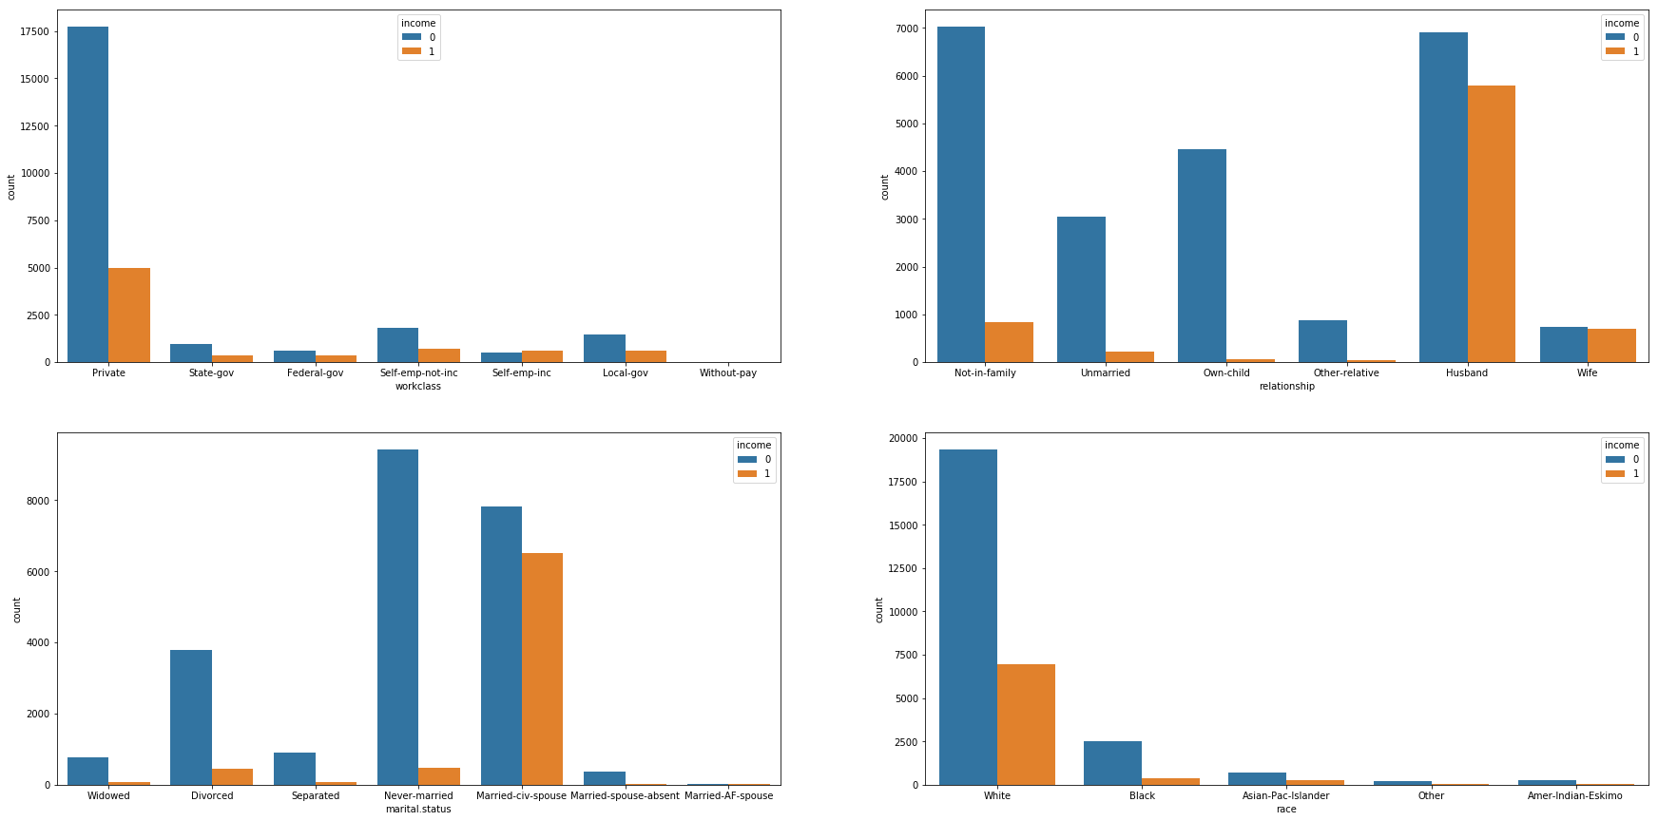
iNITIAL Data Visualization

Slide 10

Data transformation for logistic regression
1. There are some data missing, shown as “?”
-- Solution: replace “?” with nan and drop all the rows with nan
2. There are too many possible values for some categorical variables
-- Solution: group some values together
i.e., if a person’s native country is not US then categorize this person
to “Non-US”
3. The values of Income Column is ”<=50k” or “>50k”, not easy to be analyzed
-- Solution: add a new column called “y”, where 0 represents “income <=50k” and
1 represents “income >50k”

Slide 11
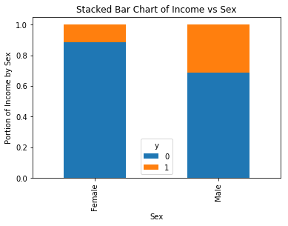
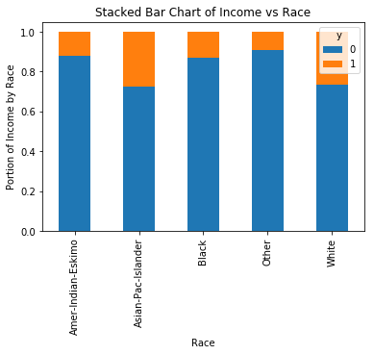
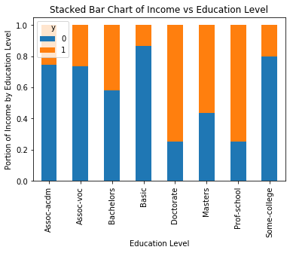
Initial data Visualization

Slide 12
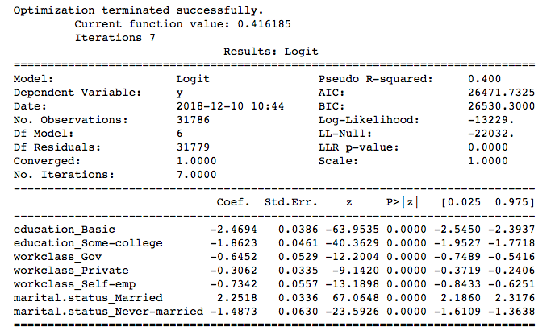
Logistic Regression analysis

Slide 13
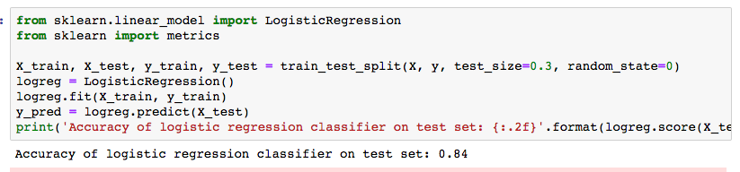
Logistic Regression analysis
The accuracy of logistic regression classifier on test set is 0.84, which is pretty good

Slide 14
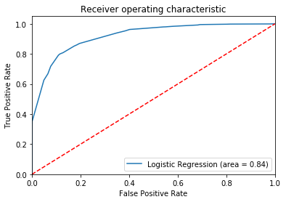
ROC Visualization

Slide 15
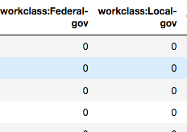
Decision tree classifier Data Transformation
Deleted education and kept education.num
Transformed Categorical Variables into Dummy Variable Matrix
Data Normalization and Standardlization
Replaced “?” with nan and drop all the rows with nan

Slide 16

Xgboost test results

Slide 17
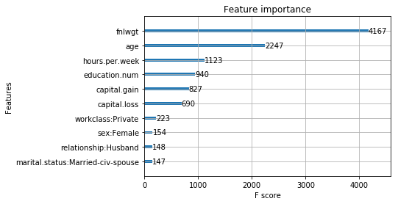
Plot feature importance visualization

Slide 18
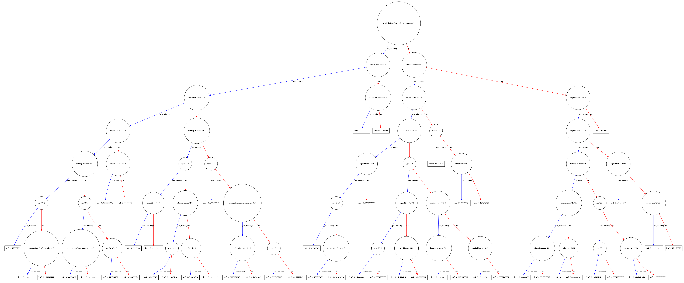
decision TREE VISUALIZATION

Slide 19
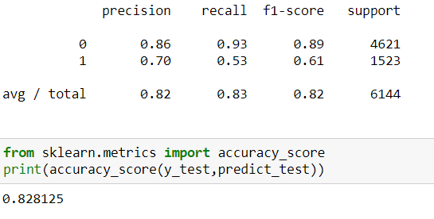
KNN

Slide 20
Questions?

